Slide 1
Olympic games can we know who will win the games by given Physical values ?
By
Shoval Nakash
GitHub: https://github.com/shovalnakash/Olympic-Games
Data science project

Slide 2
The olympic games
The modern Olympic Games or Olympics are leading international sporting events featuring summer and winter sports competitions in which thousands of athletes from around the world participate in a variety of competitions.
The Olympic Games are considered the world's foremost sports competition with more than 200 nations participating. The Olympic Games are normally held every four years, alternating between the Summer and Winter Olympics every two years in the four-year period.

Slide 3
Sport games statistics
Tokyo 2020 Sports Event
39
Venues and official stadiums
11,090
Athletes and riders
206
Expected national committees
33
New sports included for the first time
339
Gold medals to be awarded

Slide 4
Problem Definition
All over the years athletes compete in the games, and everyone wants the gold medal.
Throw the years we can see similary in the type of the wining competitions in every sport category, and each sport show us another Physical criteria.
We want to know if there is a way to predict who will going to win the games in his sport category by given physical data (height, weight, age)

Slide 5
Lets begin!

Slide 6
Research steps
01
02
03
04
Obtaining data
Handling data
Exploring data
Modeling data
05
present data
Finding good quailty of athlete data
Cleaning, filtering and delete duplicates from data
Visualizing and understanding the data
Build the algorithm for machine learning
Presentation of data and our results

Slide 7
—CARL LEWIS
“If you don’t have confidence, you’ll always find a way not to win”
American track and field athlete and nine-time gold medalist

Slide 8
01
Obtaining data

Slide 9
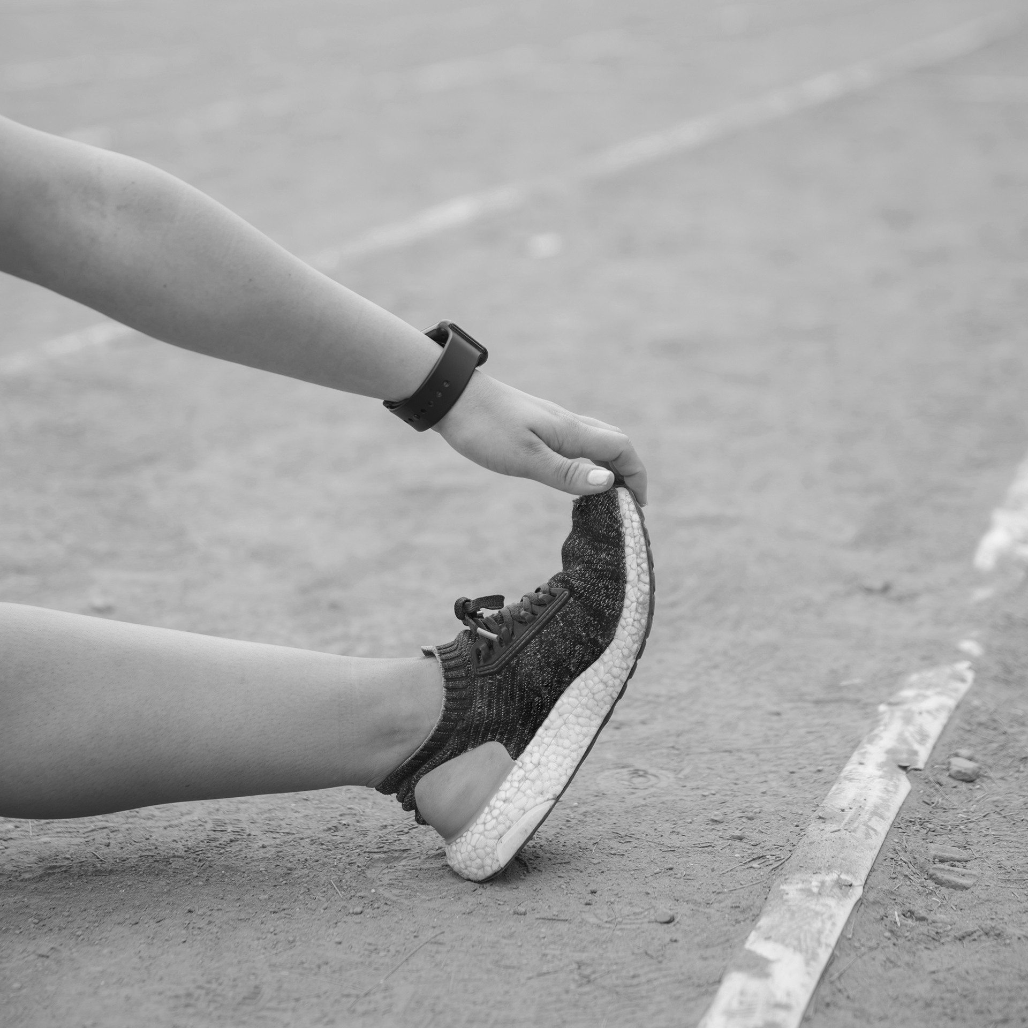
data
For my very specific question, I find a good quality of data, that is very important for our research

Slide 10
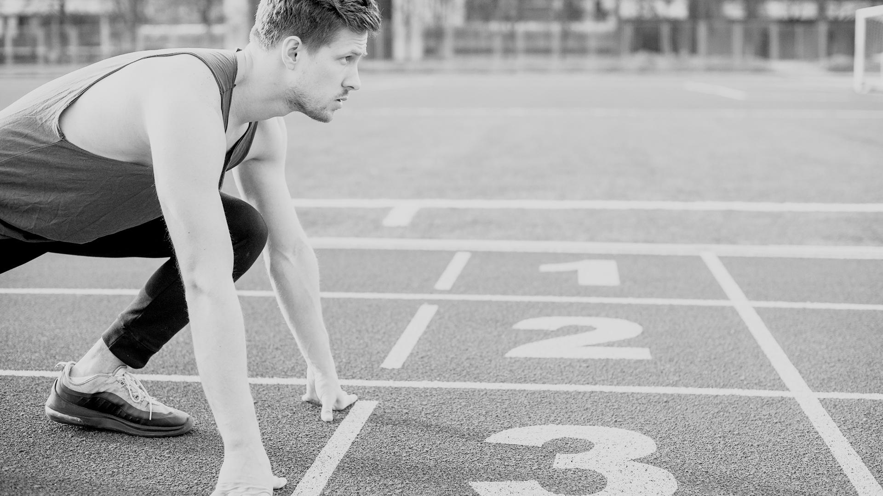
A PICTURE IS WORTH A THOUSAND WORDS

Slide 11
02
Handling data

Slide 12
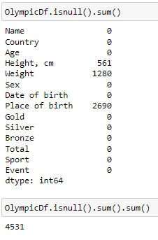
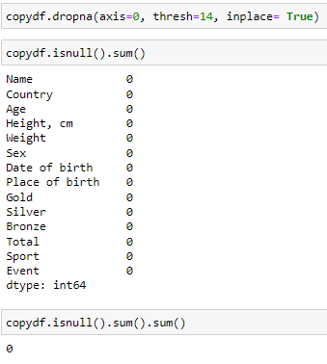
#1
#2
Dealing with duplicates:
we check the duplicates by category ‘Name’, we find out we have 12 duplicates, so we clean them
Dealing with missing values:
The value that are missing very important to us because they were the main question , so the best thing was to clean them and not fill in because it could change our learning machine

Slide 13
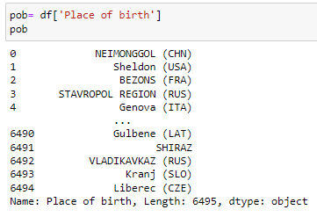
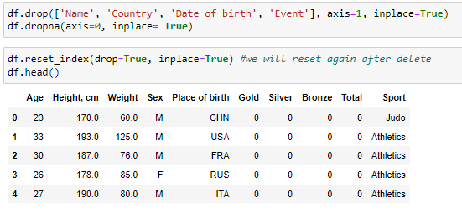
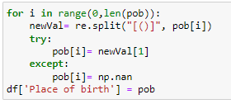
#3
#4
We drop the columns that won’t help us after
text analysis:
We had a problem with the column ‘place of birth’ because we had 3624 unique values(!) – A LOT, so we took only the name of the country by text analysis

Slide 14
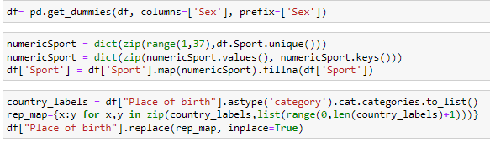
#5
turning letters to numeric-
For the step of learning machine

Slide 15
123.456.789
Big numbers catch your audience’s attention

Slide 16
03
Exploring data

Slide 17
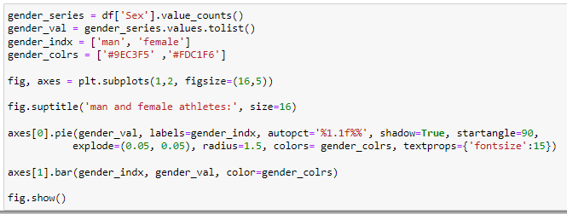
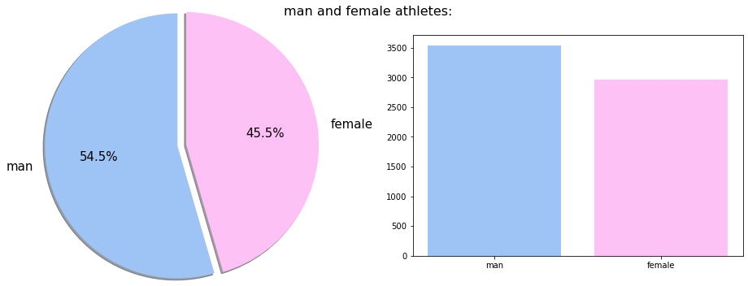

Slide 18
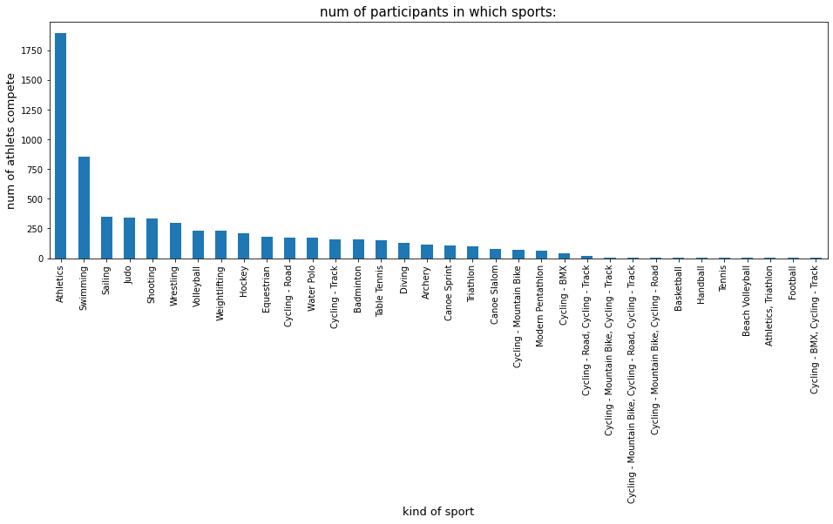
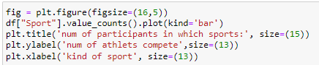

Slide 19
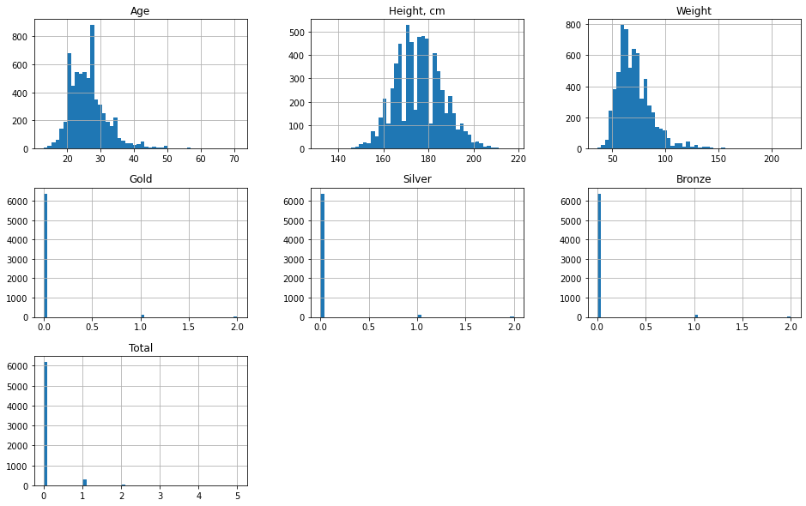
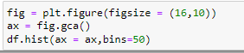

Slide 20
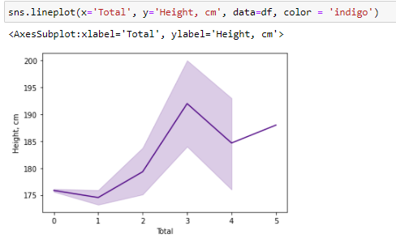
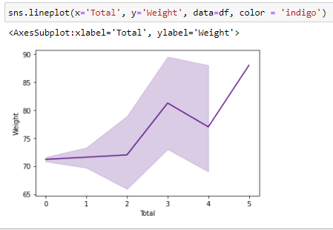
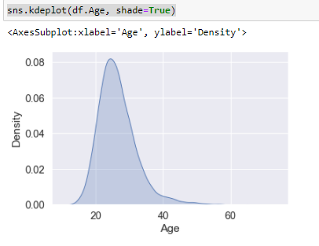

Slide 21
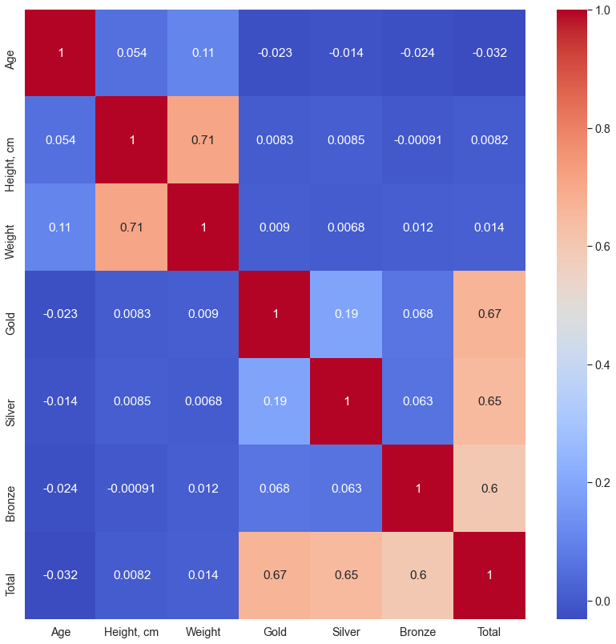
HEATMAP
This visualization technique usually shows the
magnitude of a phenomenon as color in two dimensions.
Thus, it can be used to show three variables together.
In this type of graph two of the three variables
are taken to influence - or explain - the third.
Heatmaps show us values as a function of two dimensions.

Slide 22
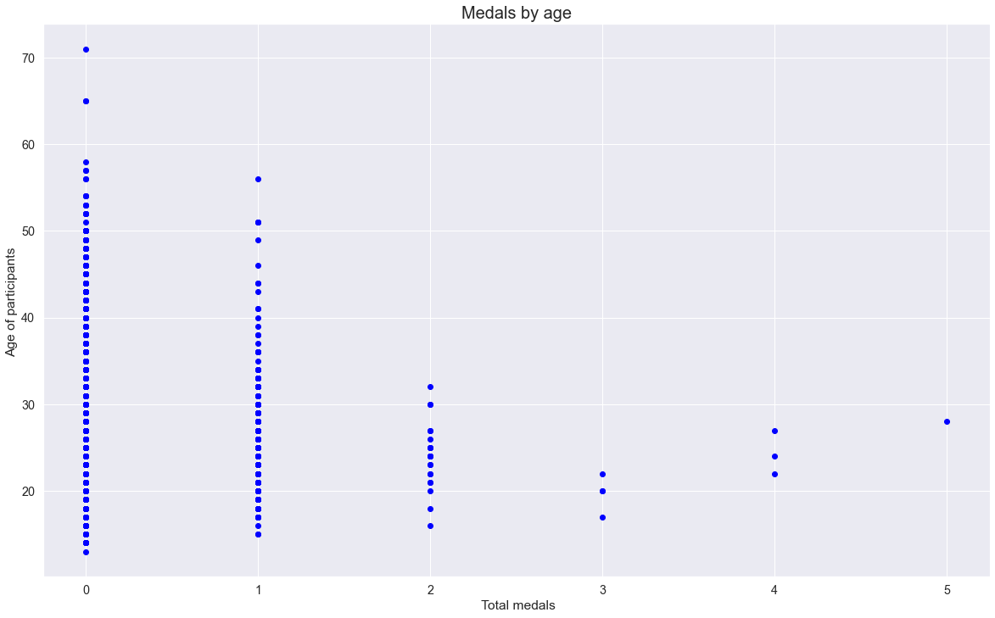

Slide 23
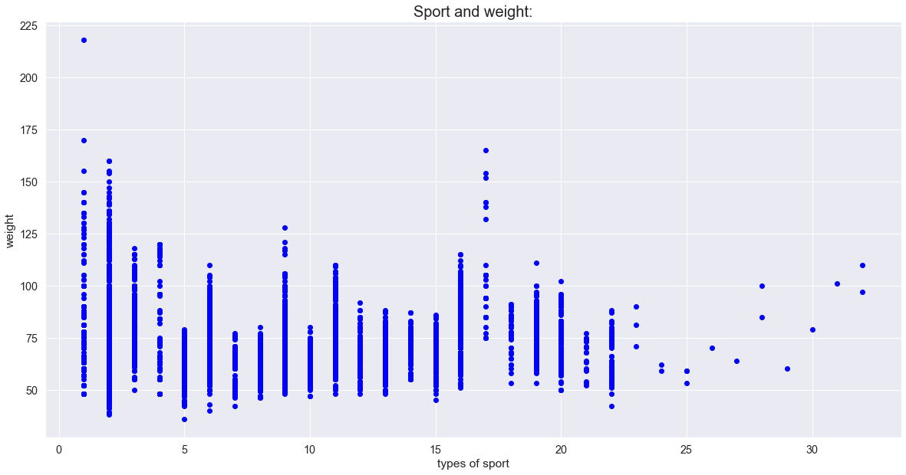

Slide 24
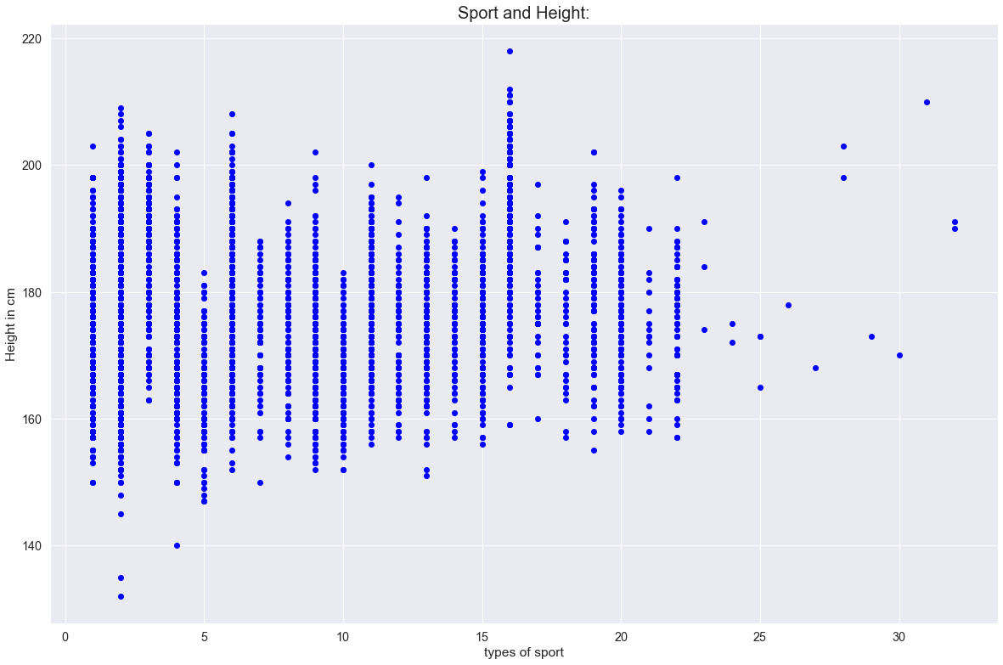

Slide 25
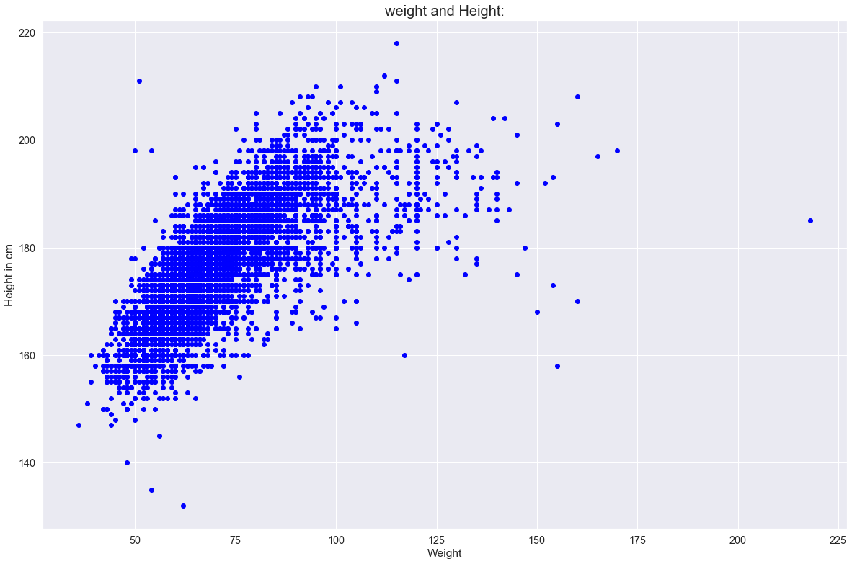
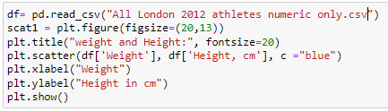

Slide 26
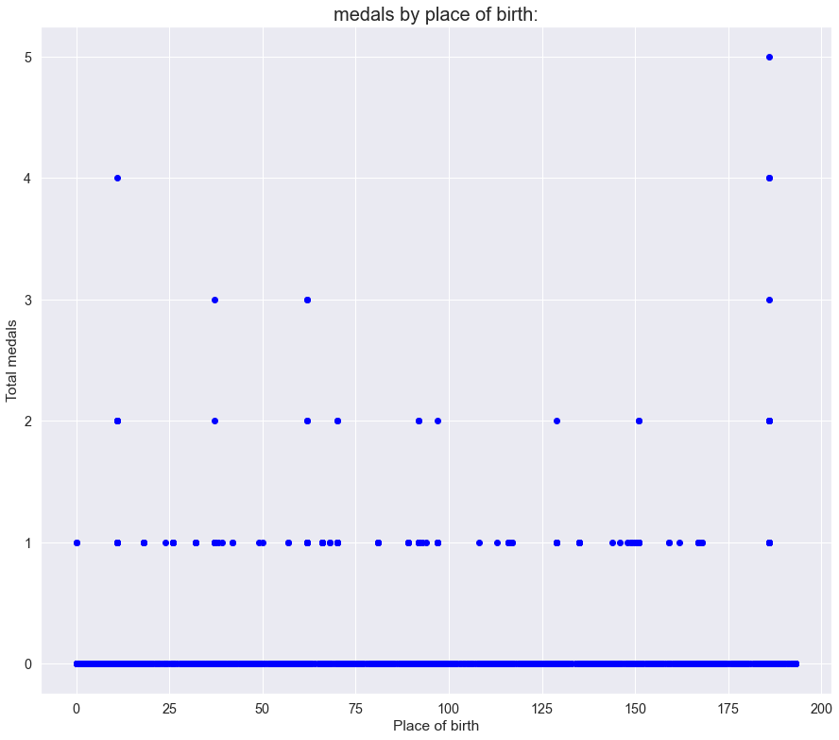

Slide 27
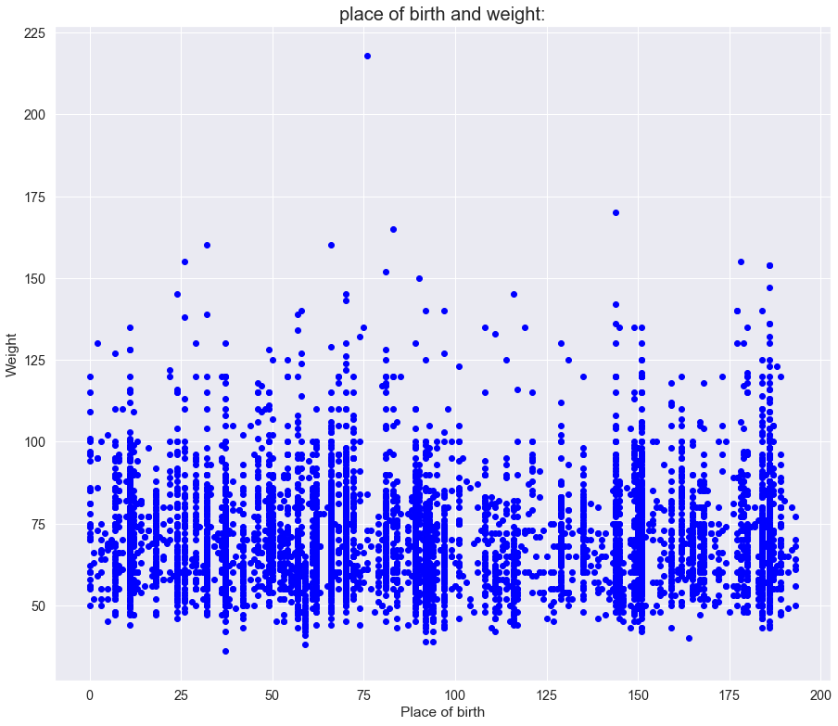

Slide 28
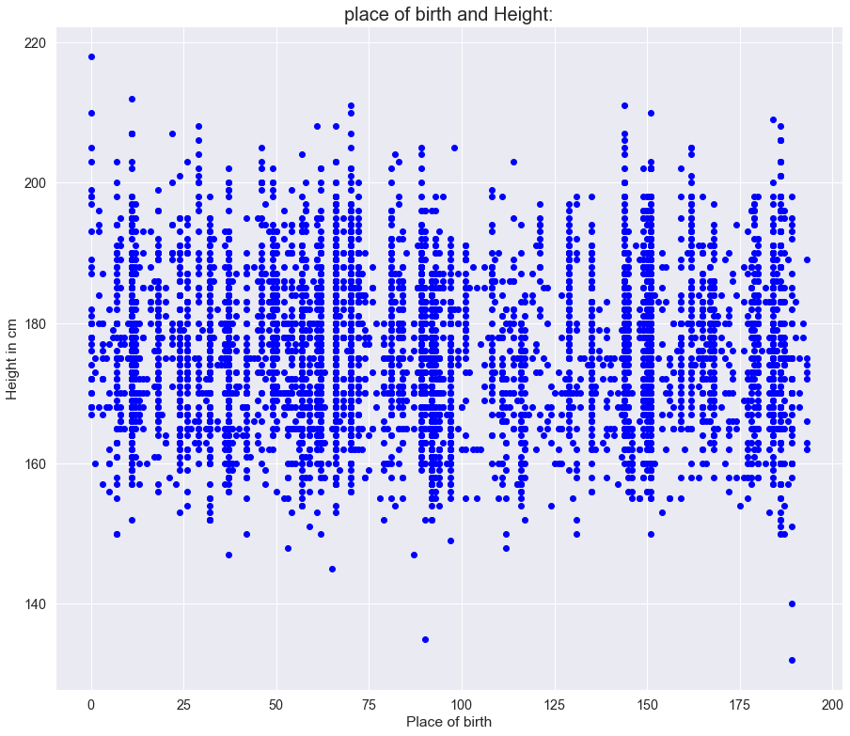

Slide 29
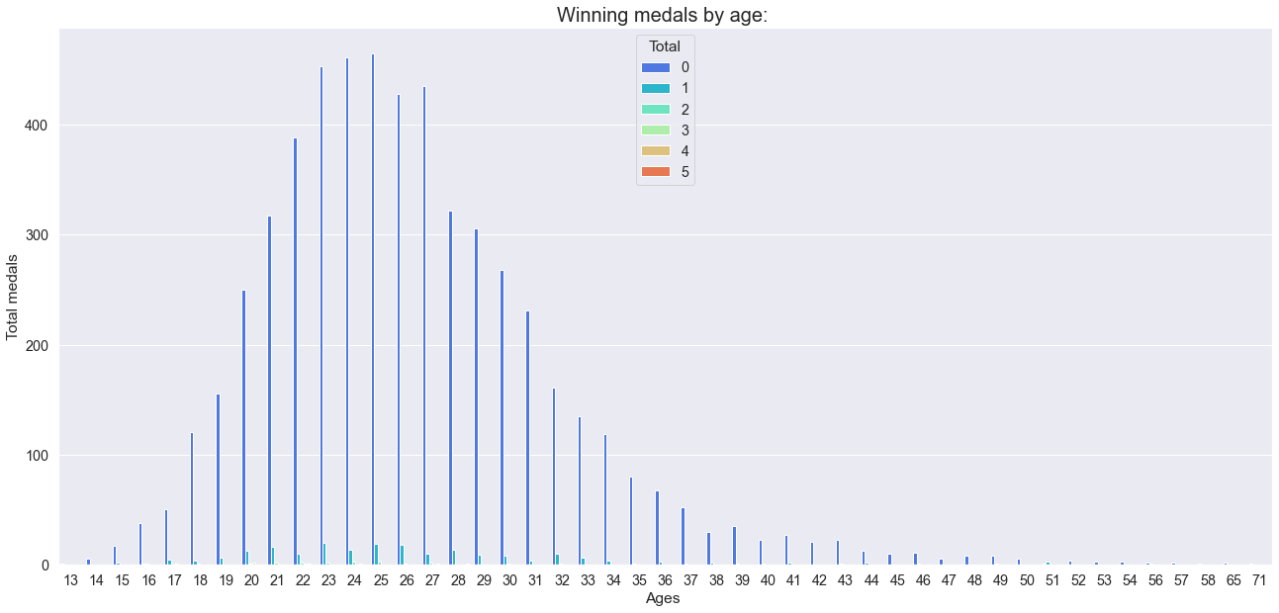

Slide 30
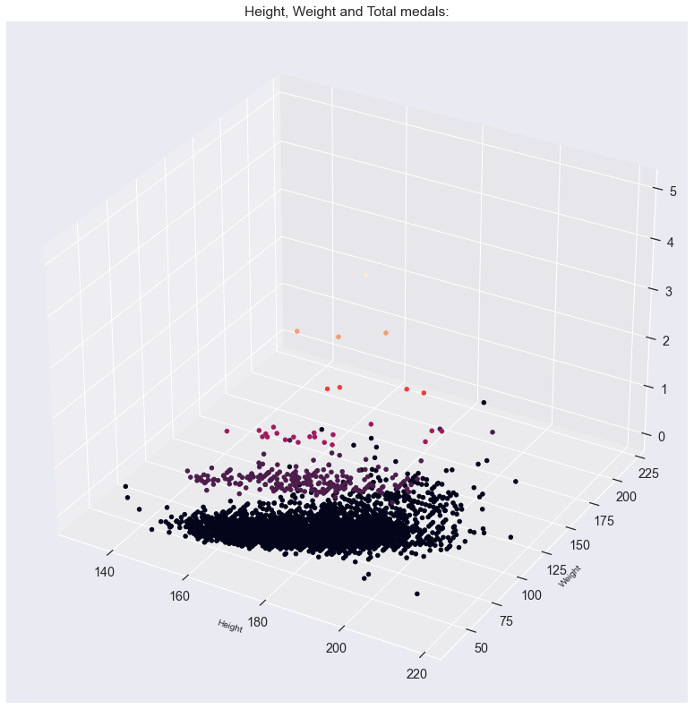
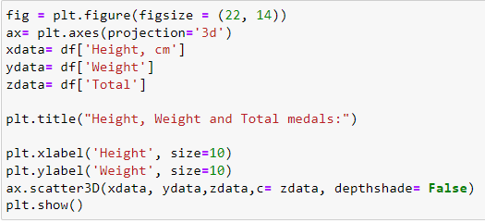

Slide 31
04
Modeling data

Slide 32
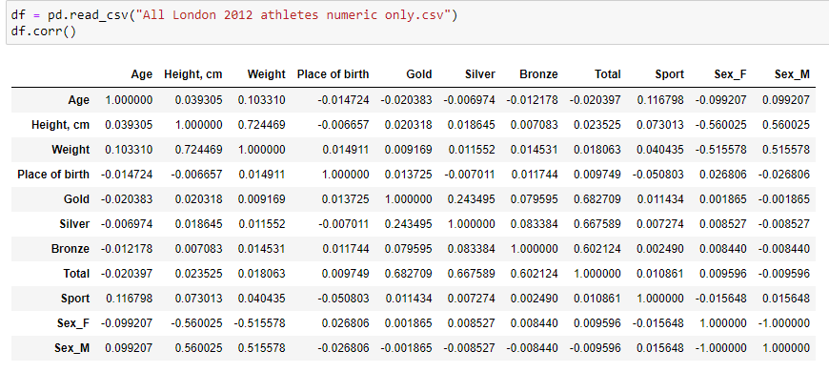
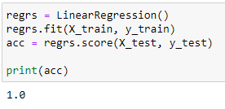
#1
Import our data with corr() to check connection
The result is too good and its not good.
#2

Slide 33
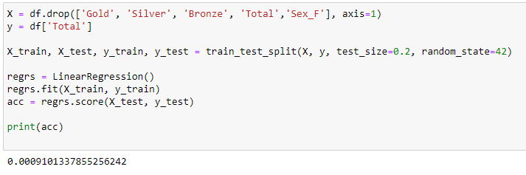
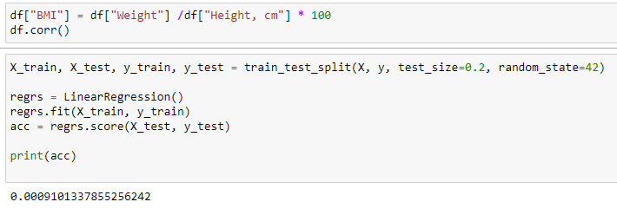
#3
#4
i tried to drop columns and check the result again
the result still not good for us, so i made a new column that calculate the BMI index:

Slide 34
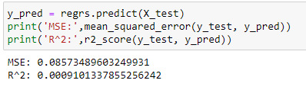
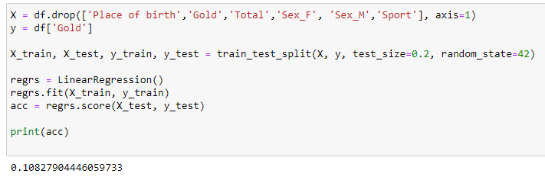
#5
#6
Checking the error:
and try it again, now with another target column (that can be the same for our question)

Slide 35
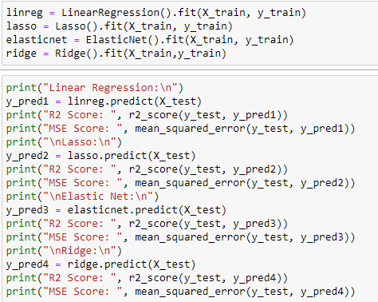
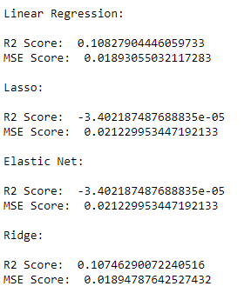
#7
checking if any other method get a better result- like you can see- no

Slide 36
credits
Data
https://www.theguardian.com/sport/datablog/2012/aug/07/olympics-2012-athletes-age-weight-height#age
PowerPoint template
https://slidesgo.com/theme/

